Slide 1

WEB TECHNOLOGIES
CSS – Box Model
and Position Property
Vinay Joshi
Department of
Computer Science and Engineering

Slide 2

CSS – Box Model and Position Property
Element support for styling
They are used to group together a chunk of HTML and hook some information onto that chunk
The difference between span and div is that a span element is in-line and usually used for a small chunk of HTML inside a line (such as inside a paragraph) whereas a div (division) element is block-line (which is basically equivalent to having a line-break before and after it) and used to group larger chunks of code.

Slide 3
CSS – Box Model and Position Property
Element support for styling
There are two elements used commonly to style specific parts of a webpage
<span>
To apply style to a part of a paragraph
<div>
To apply style to a set of elements or paragraphs

Slide 4
CSS – Box Model and Position Property
Element support for styling
Ex:
<!doctype html>
<html>
<head>
<title>div_span</title>
<style>
div{color:red;}
</style>
</head>
<body>
<div> pes have<span style="color:blue;">computer science branch</span>it is a university</div>
<div>pes is having mech branch</div>
</body>
</html>

Slide 5
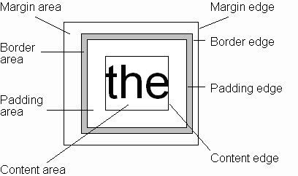
CSS – Box Model and Position Property
Box Model
Every rendered element occupies a box:
(or outer edge)
(or inner edge)

Slide 6
CSS – Box Model and Position Property
Box Model - Components
The CSS box model is a container that contains multiple properties including borders, margin, padding, and the content itself.
It is used to create the design and layout of web pages.
It can be used as a toolkit for customizing the layout of different elements.
The web browser renders every element as a rectangular box according to the CSS box model.
Box-Model has multiple properties in CSS. Some of them are given below:

Slide 7
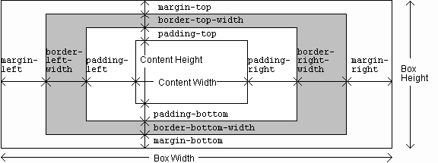
CSS – Box Model and Position Property
Box Model - Components

Slide 8
CSS – Box Model and Position Property
Box Model - Components
Content Area: This area consists of content like text, images, or other media content. It is bounded by the content edge and its dimensions are given by content-box width and height.
Padding Area: It includes the element’s padding. This area is actually the space around the content area and within the border-box. Its dimensions are given by the width of the padding-box and the height of the padding-box.
Border Area: It is the area between the box’s padding and margin. Its dimensions are given by the width and height of the border.
Margin Area: This area consists of space between border and margin. The dimensions of the Margin area are the margin-box width and the margin-box height. It is useful to separate the element from its neighbors.

Slide 9
CSS – Box Model and Position Property
Box Model - Components
The total width for the element can be calculated as:
Total element width = width + left padding + right padding + left border + right border + left margin + right margin
div {
width: 320px;
padding: 10px;
border: 5px solid gray;
margin: 0;
}
320px (width) + 20px (left + right padding) + 10px (left + right border) + 0px (left + right margin) = 350px

Slide 10
CSS – Box Model and Position Property
Position Property
The CSS position property is used to set position for an element. it is also used to place an element behind another and also useful for scripted animation effect.
You can position an element using the top, bottom, left and right properties. These properties can be used only after position property is set first. A position element's computed position property is relative, absolute, fixed or sticky.
Let's have a look at following CSS positioning:
CSS Static Positioning
CSS Fixed Positioning
CSS Relative Positioning
CSS Absolute Positioning

Slide 11
CSS – Box Model and Position Property
Position Property
1) CSS Static Positioning
This is a by default position for HTML elements.
It always positions an element according to the normal flow of the page.
It is not affected by the top, bottom, left and right properties.

Slide 12
CSS – Box Model and Position Property
Position Property
CSS Fixed Positioning
The fixed positioning property helps to put the text fixed on the browser. This fixed test is positioned relative to the browser window, and doesn't move even you scroll the window
<style>
p.pos_fixed {
position: fixed;
top: 50px;
right: 5px;
color: blue;
}
</style> .

Slide 13
CSS – Box Model and Position Property
Position Property
CSS Relative Positioning
The relative positioning property is used to set the element relative to its normal position.
<style>
h2.pos_left {
position: relative;
left: -30px;
}
h2.pos_right {
position: relative;
left: 30px;
}
</style>

Slide 14
CSS – Box Model and Position Property
Position Property
CSS Absolute Positioning
The absolute positioning is used to position an element relative to the first parent element that has a position other than static. If no such element is found, the containing block is HTML.
With the absolute positioning, you can place an element anywhere on a page.
<style>
h2 {
position: absolute;
left: 150px;
top: 250px;
}
</style>

Slide 15
CSS – Box Model and Position Property
Position Property
Sticky: The element with position: sticky and top: 0 played a role between fixed & relative based on the position where it is placed.
A sticky element toggles between relative and fixed, depending on the scroll position. It is positioned relative until a given offset position is met in the viewport - then it "sticks" in place (like position:fixed).

Slide 16
CSS – Box Model and Position Property
Position Property
S.No. | Position: fixed | Position: Sticky
1. | Element with position: fixed property is fixed to the viewport and doesn’t move irrespective of scrolling. | Element with position: sticky property can scroll to an offset value provided by the user.
2. | Element with position: fixed property never leaves the viewport position it was fixed to. | Element with position: sticky property leaves the viewport when its parent element scrolls off the viewport.

Slide 17
CSS – Box Model and Position Property
Position Property

Slide 18
CSS – Box Model and Position Property
Position Property

Slide 19
CSS – Box Model and Position Property
Position Property

Slide 20
THANK YOU
Vinay Joshi
Department of Computer Science and Engineering
vinayj@pes.edu
+91 80 2672 6622

